Slide 1
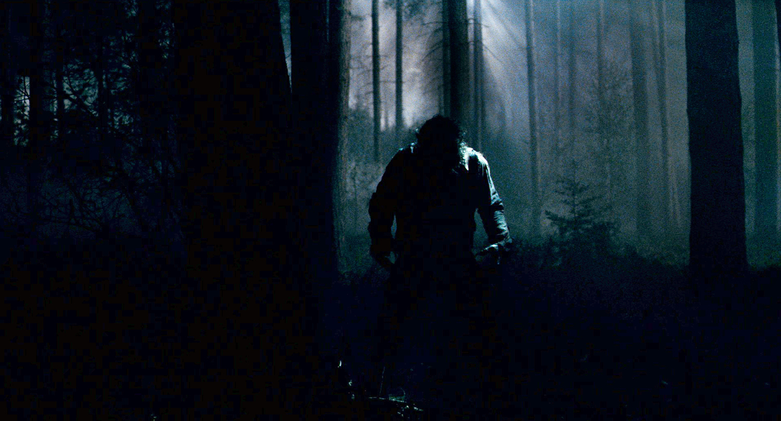

TO DISCOVER QUICK AND EFFECTIVE ROUTES AGAINST STREET ABUSE

Slide 2

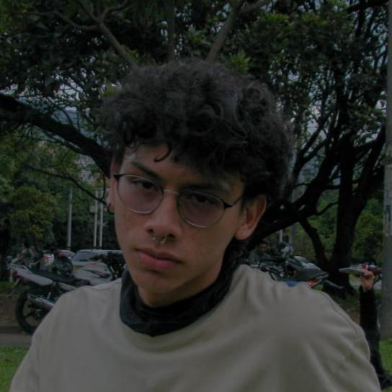

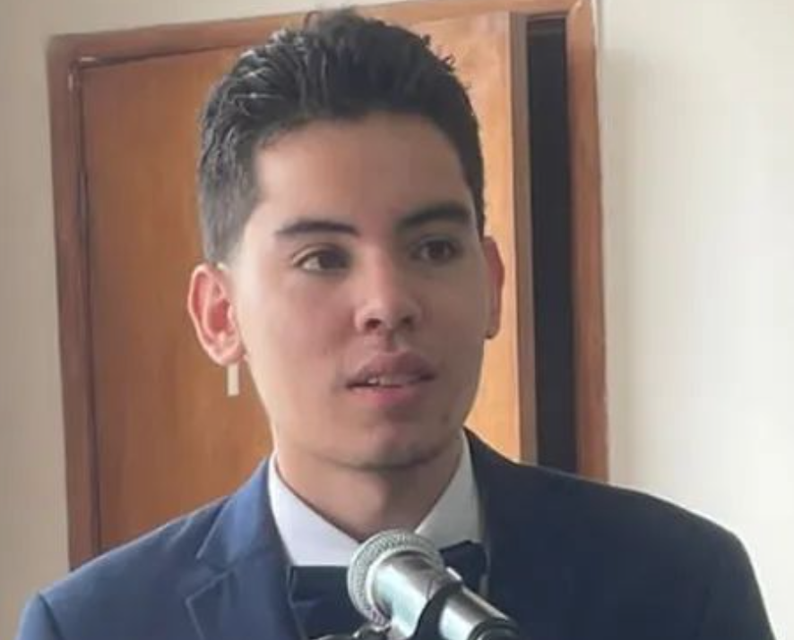


Team Presentation
Juan Martín Espitia
Redactor and designer
David Alejandro Blandon
Data management
Daniel Betancur
Writer and Investigator
https://github.com/jmespitiag/Routes_against_street_harassment.git

Slide 3
Solution algorithm
Dijkstra’s algorithm
Streets of Medellin, Origin y Destination
a path that reduces both distance and harassment

Slide 4

Problem statement
Algorithm for the shortest path
Streets of Medellin, Origin y Destination
Three paths that reduce both the risk of harassment and distance

Slide 5
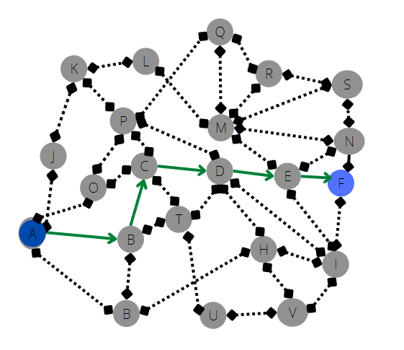
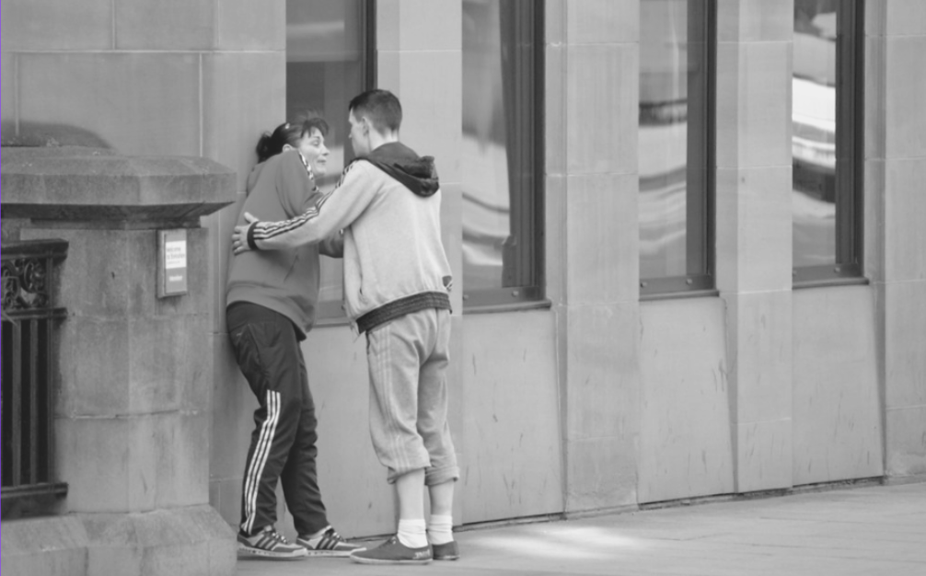
Explanation of the algorithm
Dijkstra’s Algorithm
Determine the shortest path to execute from a source vertex to the rest of the vertices located in a graph with weights on each edge

Slide 6

Complexity of the algorithm
 | Time complexity | Complexity of memory
Dijkstra | O(V*E) | O(V)
Time and memory complexity of the algorithm name. V is the total of vertex and E is the total of edges. Because in the worst case we have to explore each vertex according to the number of edges in the graph

Slide 7
Complete this slide
For the third installment
First path minimizing distance
Origin | Destination | Distance (meters) | Risk of harassment (between 0 and 1)
EAFIT University | National University | 8271.732 | 0.3426656395998138
Distance and risk of harassment for the path that minimizes distance, the red one. Execution time of 48.43116044998169 seconds.

Slide 8
Second path minimizing harassment
Origin | Destination | Distance (meters) | Risk of harassment (between 0 and 1)
EAFIT University | National University | 11094.12200000000 | 0.17961546553318125
Distance and risk of harassment for the path that minimizes harrassment risk, the green one. Execution time of 47.329102516174316 seconds.

Slide 9
Third path minimizing average of distance and harassment
Origin | Destination | Distance (meters) | Risk of harassment (between 0 and 1)
EAFIT University | National University | 10774.1360000000 | 0.18446993757461858
Distance and risk of harassment for the path that minimizes average of distance and harassment risk, the purple one. Execution time of 48.064085245132446 seconds.

Slide 10
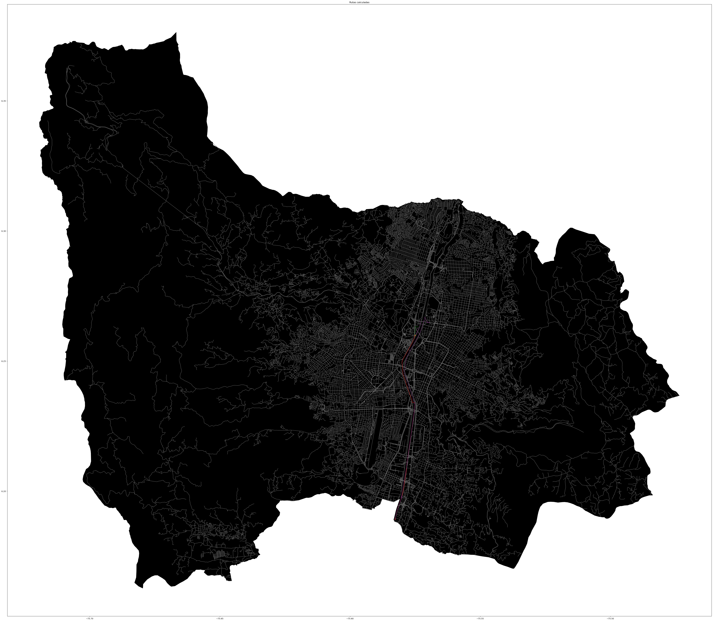
Visual comparison of the three paths

Slide 11

Future work directions
Databases
Data Structure II
Software Engineering
Emphasis Line
Other variables
Optimization
Mobile application
Apply the knowlegde

Slide 12
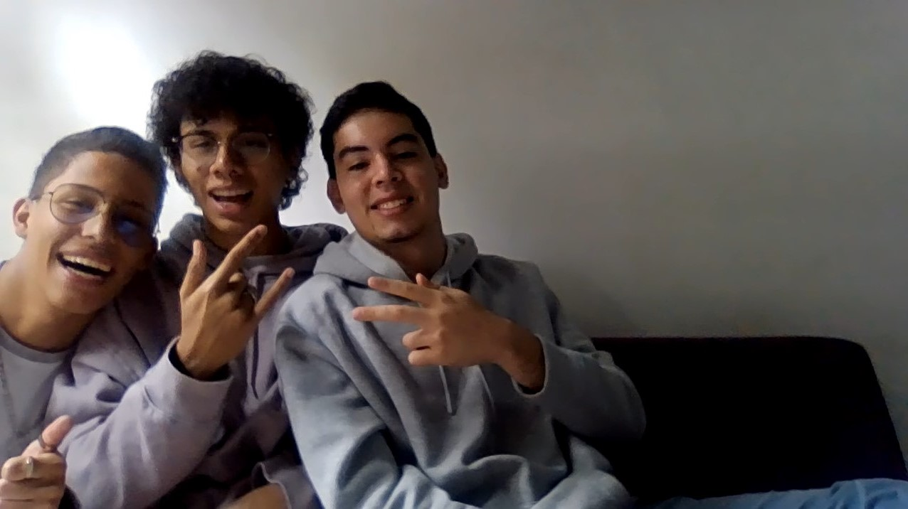
THANK YOU!!!
With the support of
The first author was supported by the Generacion E grant and Sapiencia fondo EPM grant, the second autor was supported by Andi-EAFIT scholarship and the third autor was financed by his mom Mairena Rodriguez who loves him to much. . All authors are grateful to the Vice Rector's Office for Discovery and Creation, Universidad EAFIT, for their support in this research.

